Slide 1
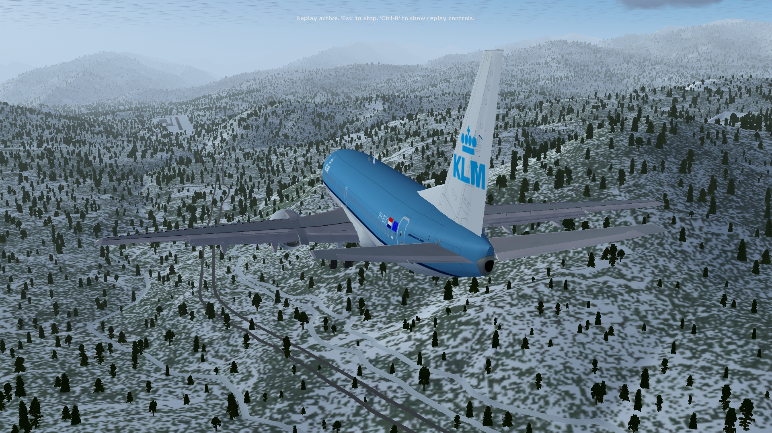
Flying to the Hills
Will Kuhlike
David Rodriguez
Alex Tschinkel

Slide 2
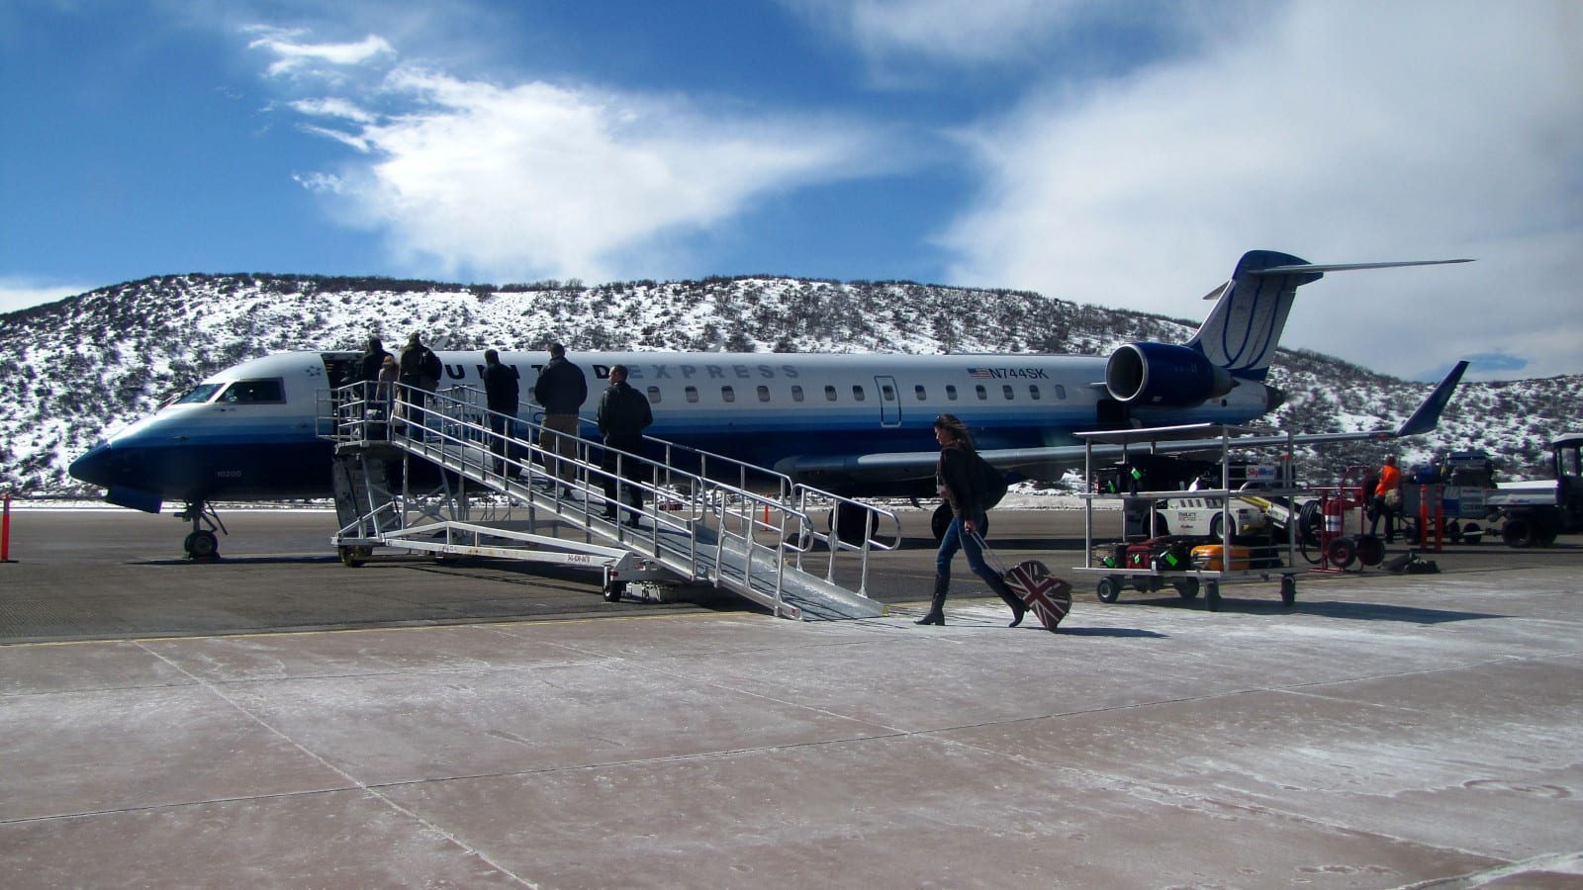
Our Goals
Bring Texas to the Mountains
Increase tourism in Aspen, Colorado
Bring Bigger Planes to Smaller Airports
Utilize Common Type Rating
Bombardier CRJ 701-ER Parked at Aspen
Notes:
Points:
Texas to the mountains
Increase tourism: Currently, there are no direct flights to Aspen from el paso. This trip would save time and be more fuel-efficient than presently available options. This could be the first of a collection of 737-500 flights from other airports.
Bring bigger planes: While this airport allows up to a plane of the size we are using, it more commonly has traffic from ~70 seat planes. One 737-500 actually did land here in 2018, without issue, so it is possible.
Common type: Type rating is the certification to fly the specific plane. Many many pilots have 737 rating, and pilots trained on other 737 variants do not need to be retrained.

Slide 3

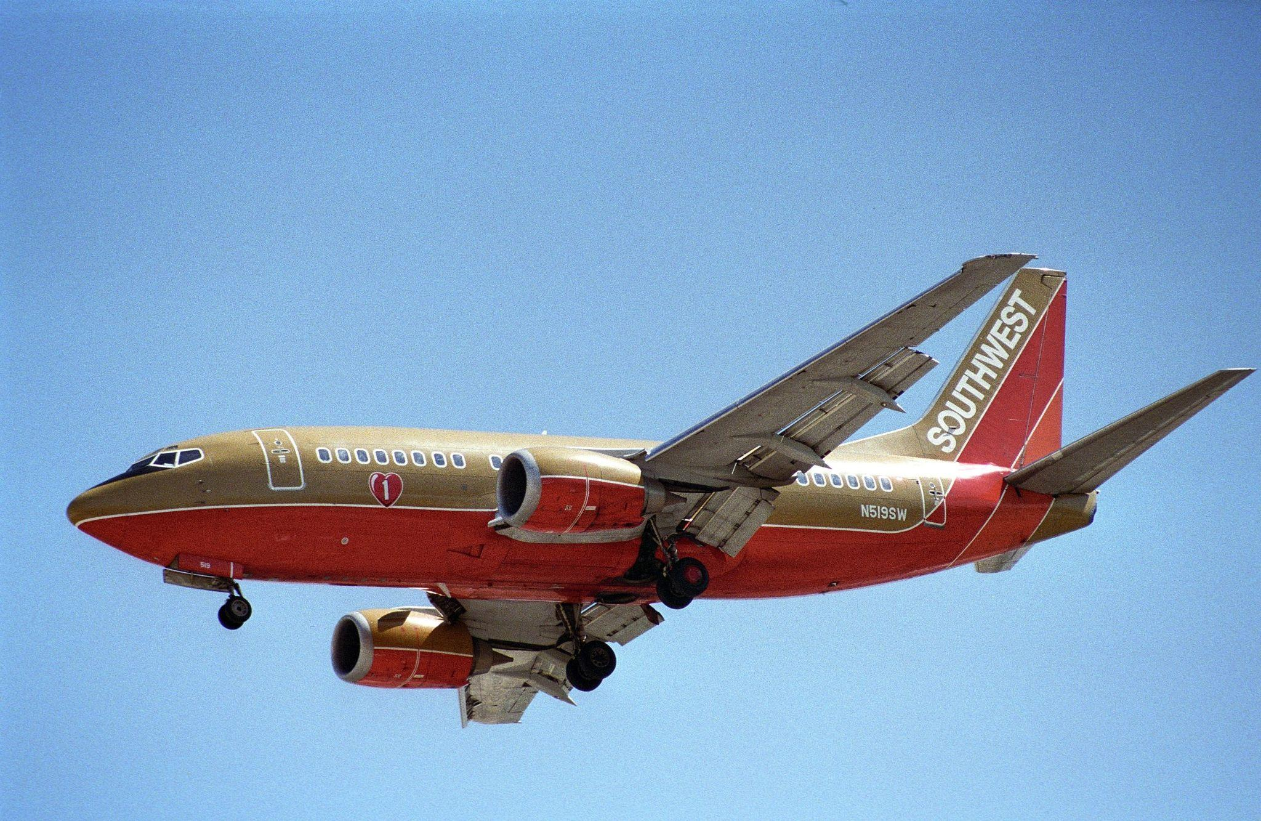
Our Fleet
The Route Network of Southwest Airlines
Boeing 737-300
Notes:
% Southwest operate out of Texas and do not currently have flights to Aspen. This would introduce them into this specific tourism market as a premium option.
-500 is the smallest variant of the 737, has a shorter wing than the newer ones, allowing us to legally land at our particular destination airport. Benefits:
- still has capacity for 140, double that of current planes landing at Aspen
- 737-500 is more fuel efficient than other “old” 737 designs, so the flight would overall be quite economical.
- Southwest’s entire fleet is 737s, so there should be no retraining needed.
- Southwest was flying them as recently as 2016.

Slide 4
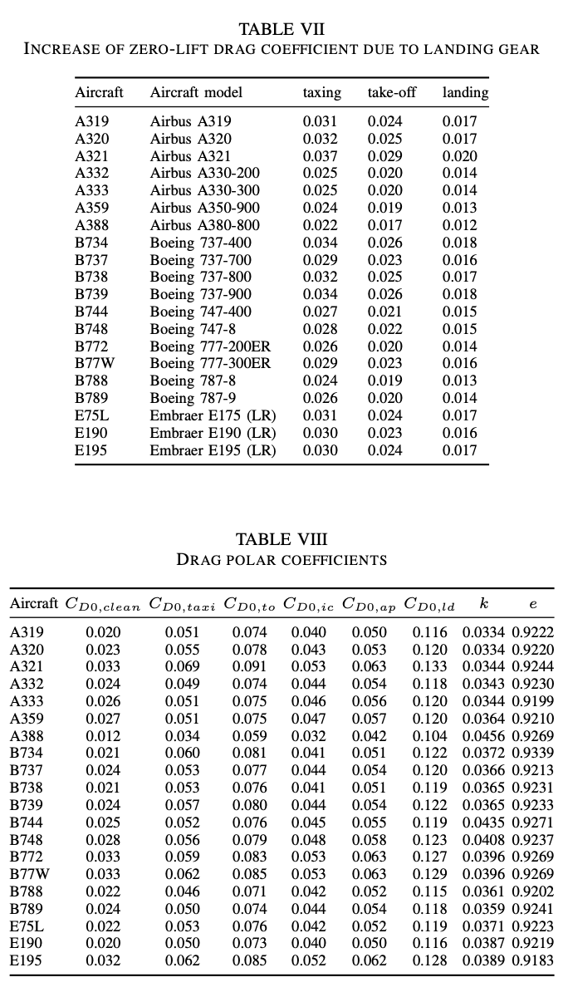
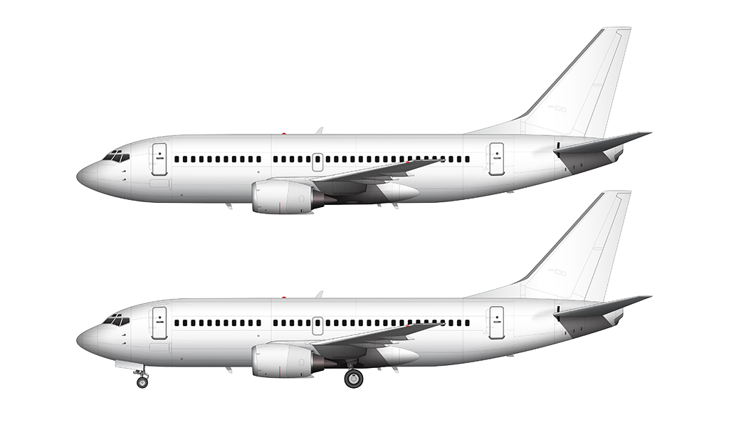
Boeing 737-300
LOA: 106’
Wingspan: 94’9”
MTOW: 124,500 lb
MLW: 114,000 lb
OEW: 105,000 lb
Range: 2950 nmi
Engines: CFM56-3C-1
CL(max): 2.16

Slide 5
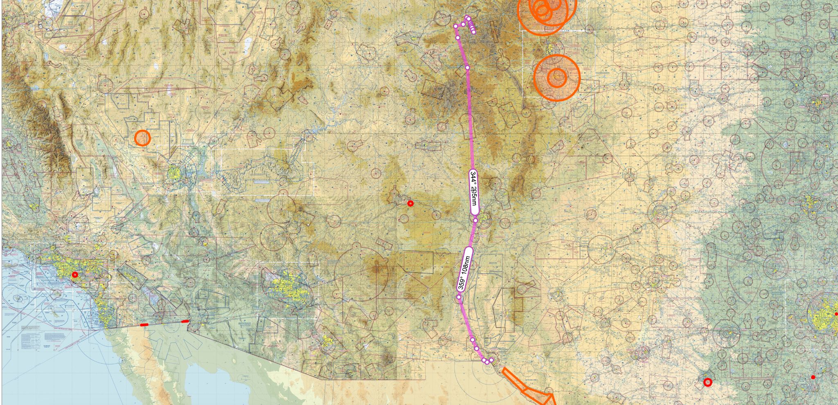
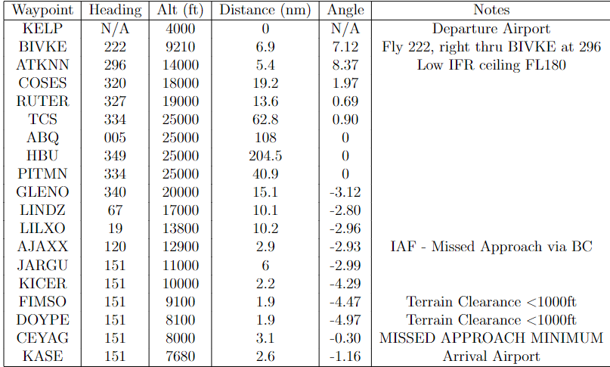
Our Route: El Paso Intl - Aspen/Pitkin Co.
El Paso to Aspen: 513 mi, Scheduled Flight Time 1:35
Notes:
Similar Length Flight: MSP-IND scheduled at 1:30

Slide 6
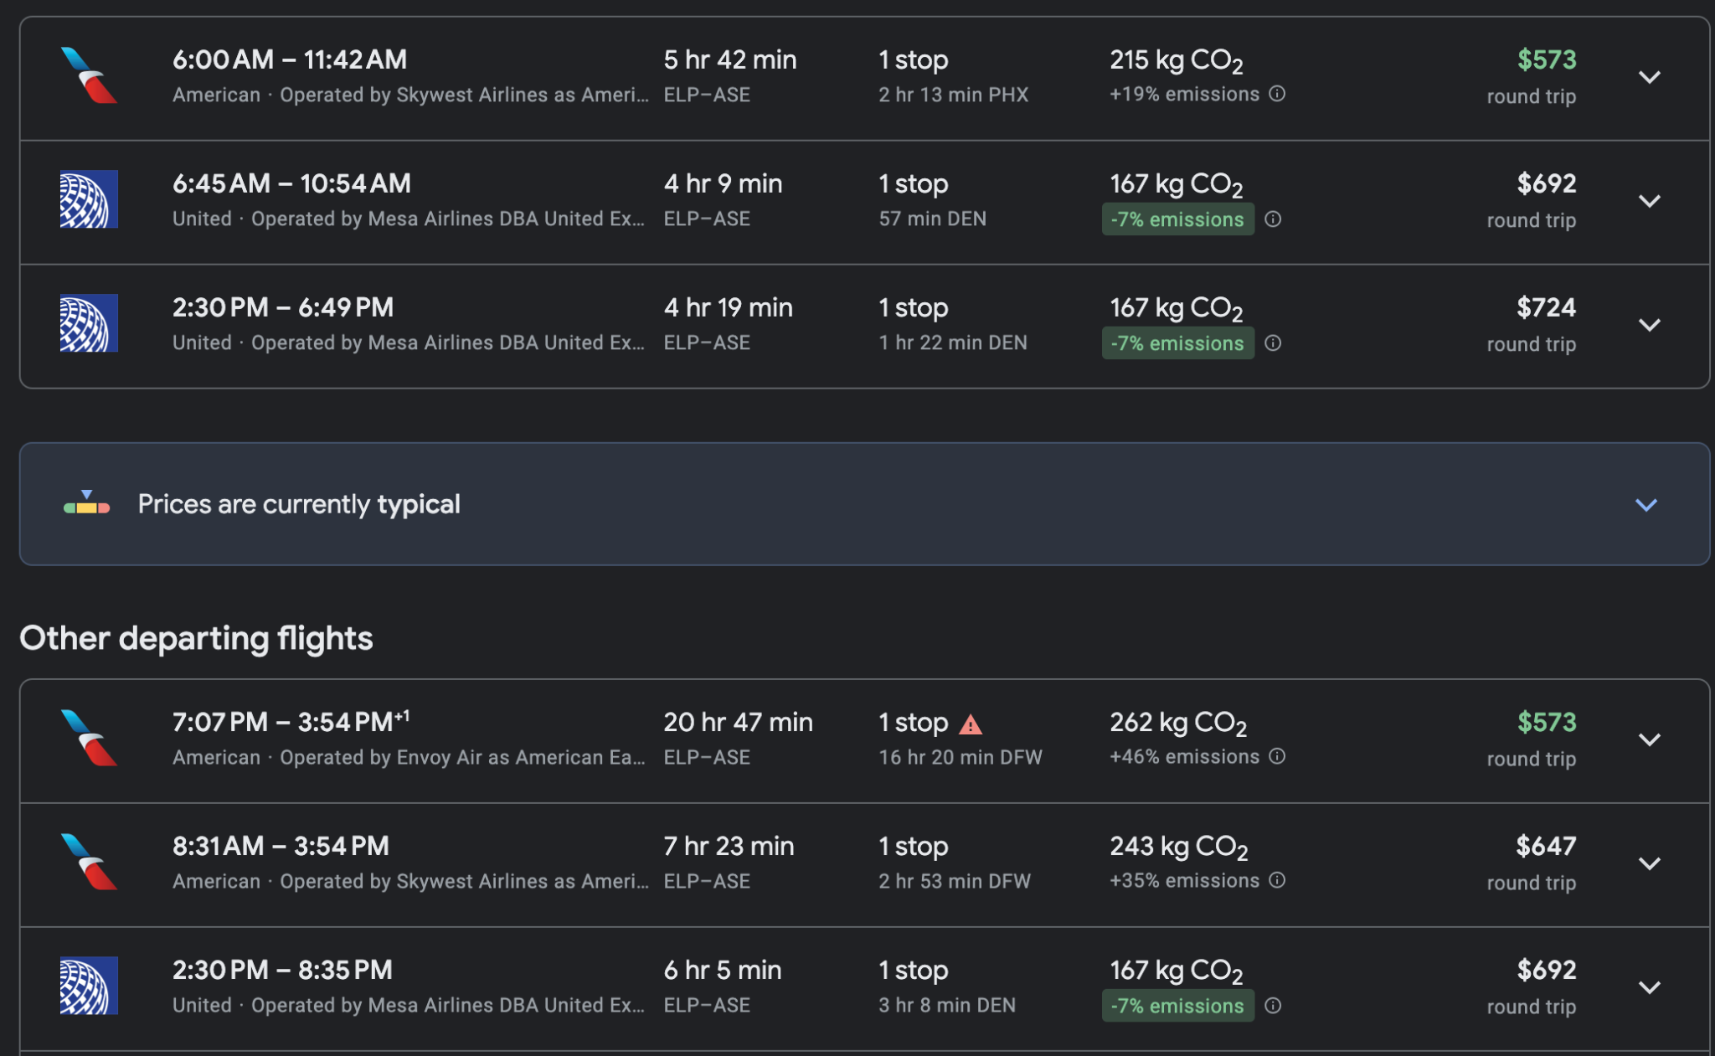
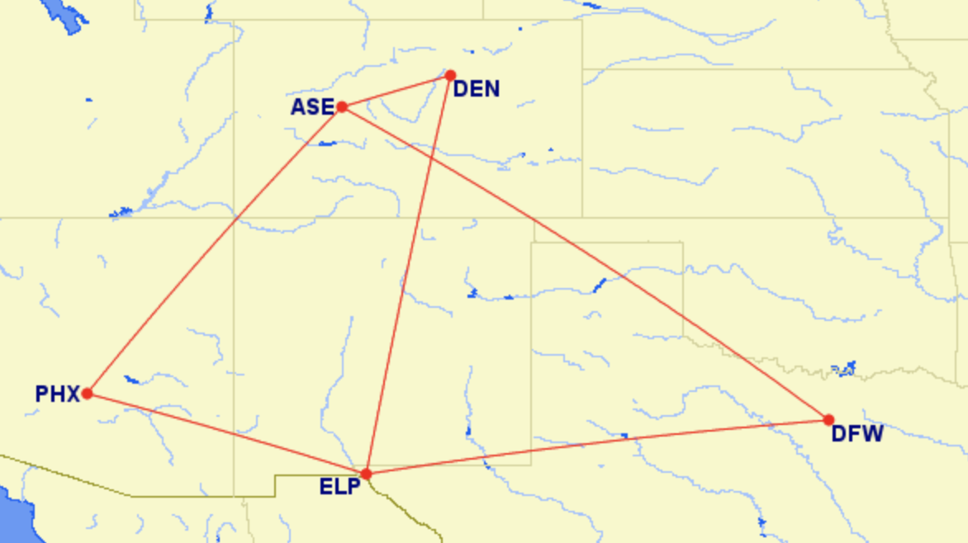
Competition
Sample Flights in Mid/Late December

Slide 7
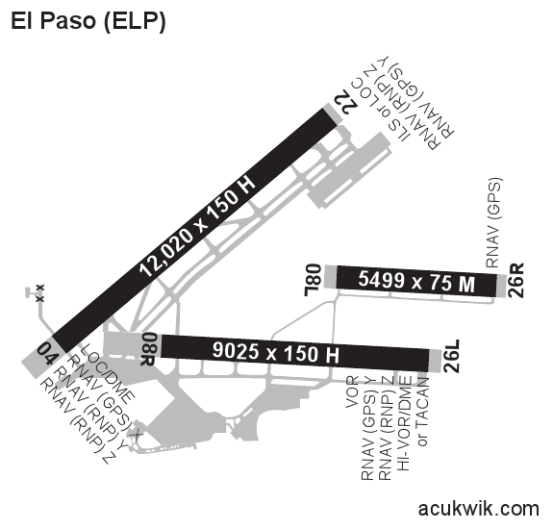
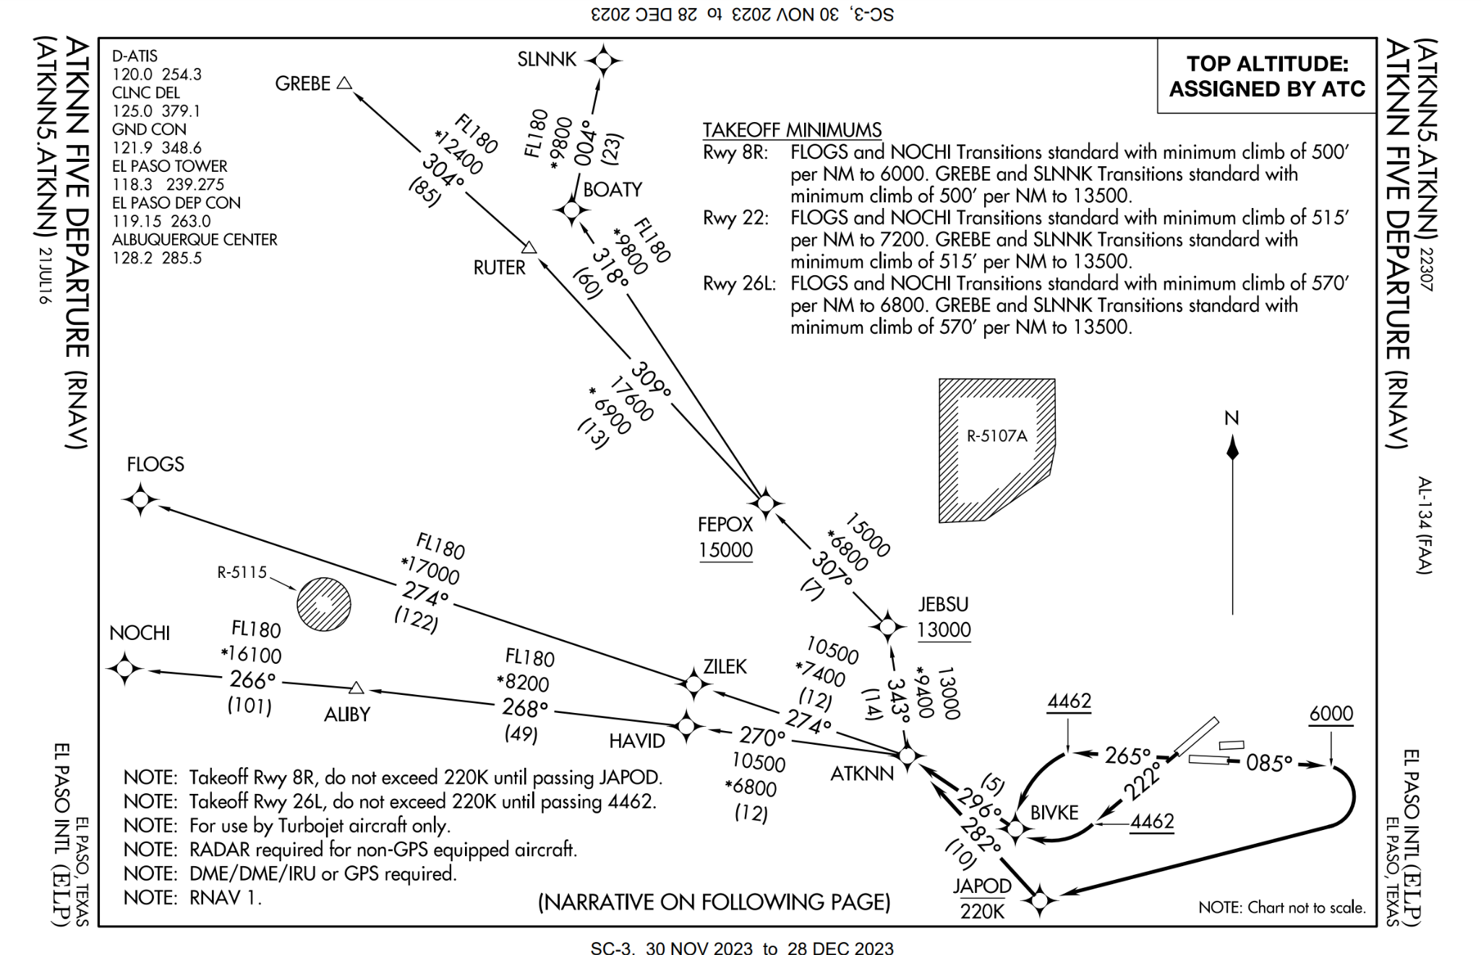
Airports - KELP

Slide 8
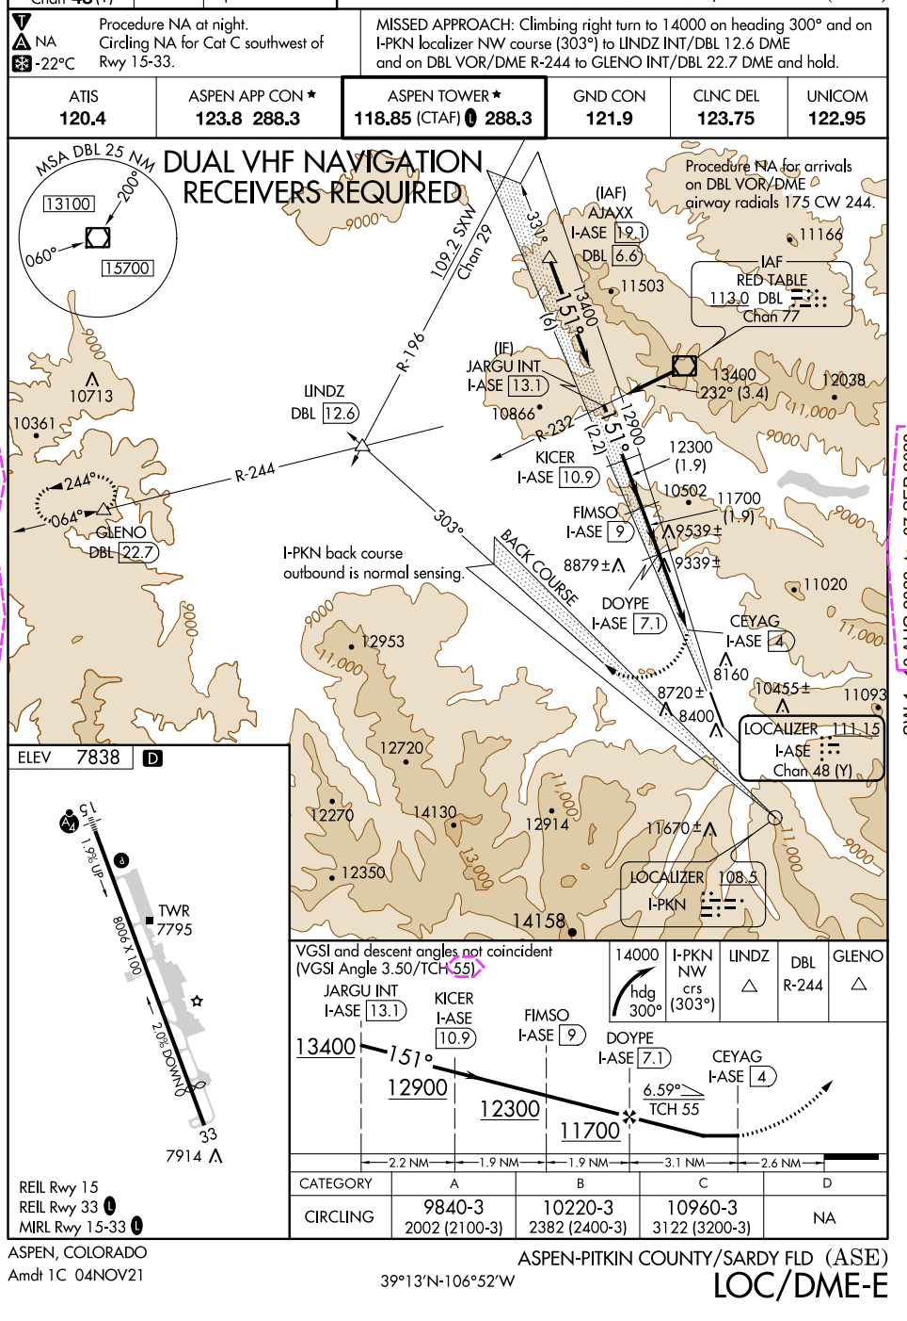
Airports - KASE
Mountain Valley
Steep Glide Angle
Narrow Approach Corridor
Short Runway
Altitude: 7,680 ft
Selected Approach
Alternate Approach

Slide 9
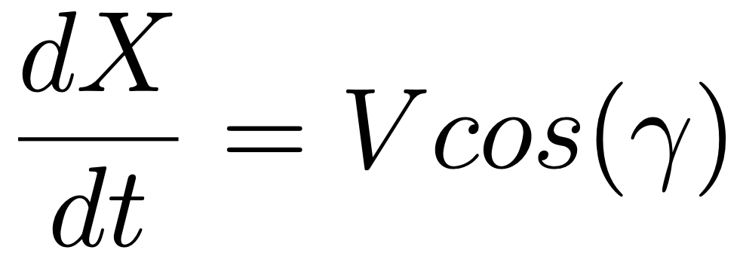


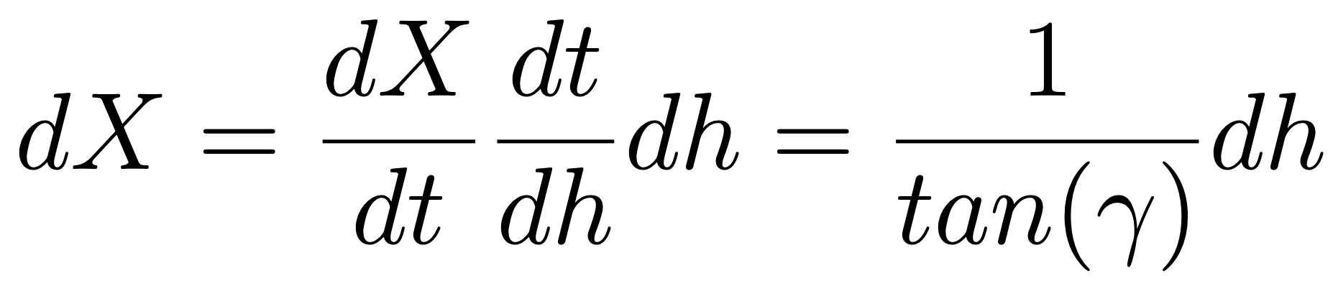
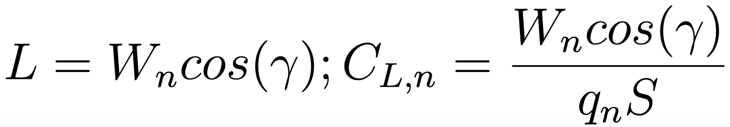
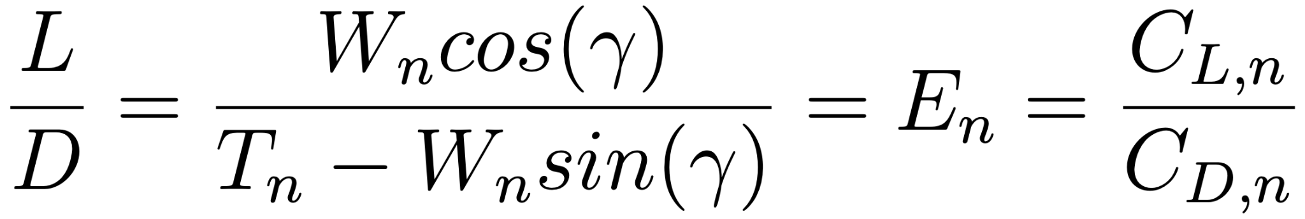
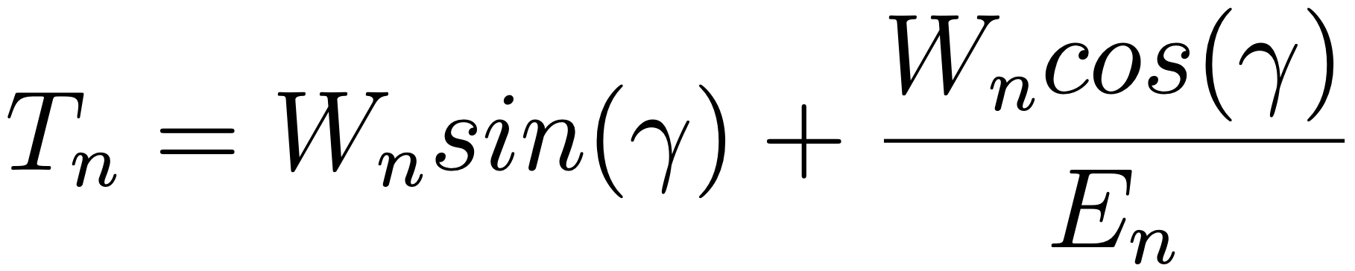
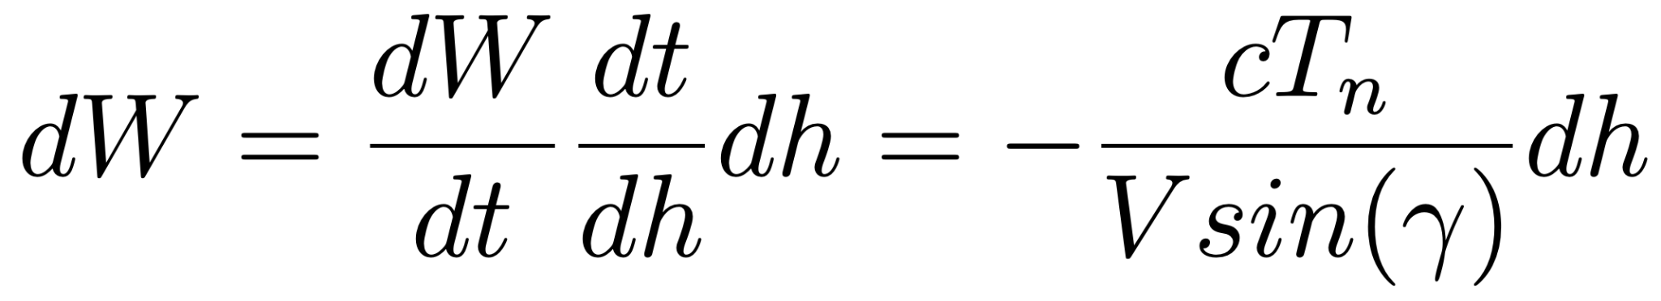
Calculations: Climb and Approach
Flight angle:
Instantaneous Efficiency:
Necessary Thrust
Notes:
Discrete integration to estimate fuel consumption, while considering weight, thrust, and dynamic pressure as variables
“Dh” is the altitude step used in discrete integration

Slide 10
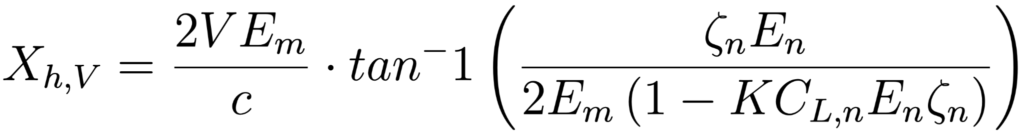
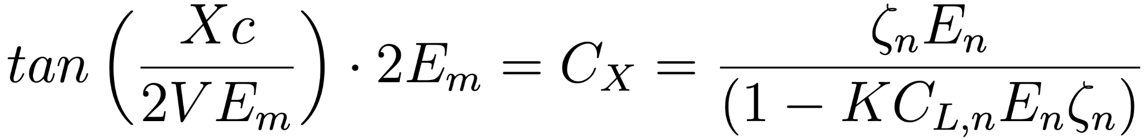
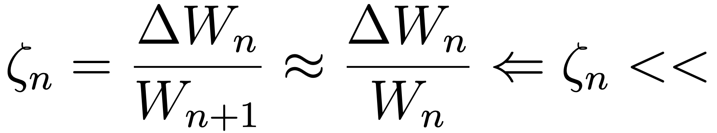


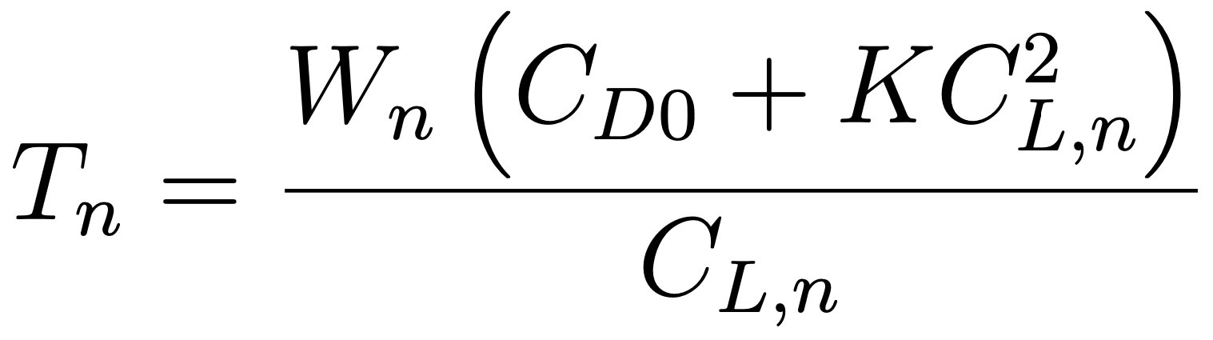
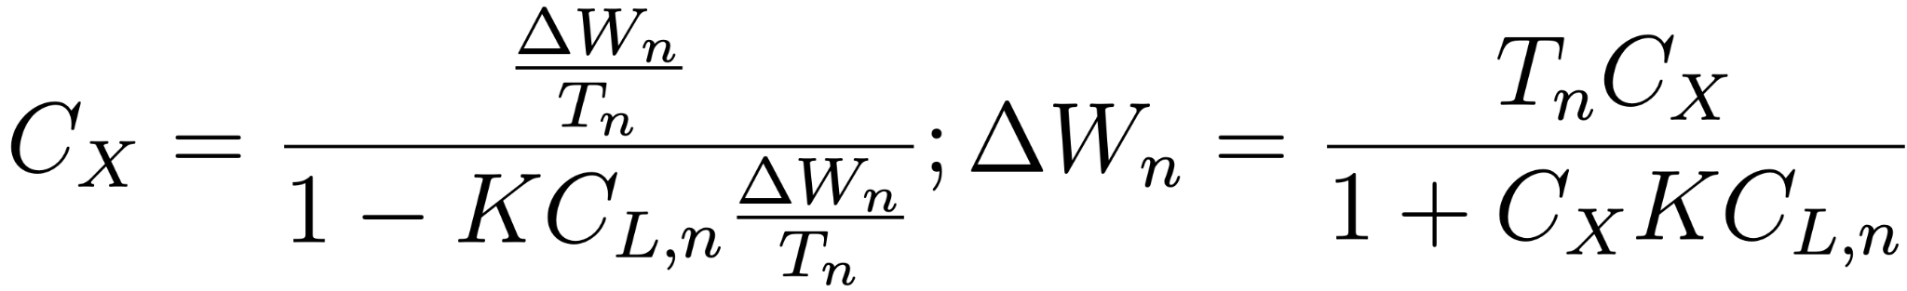
Calculations: Cruise/Level Flight
Isolate Constants:
Necessary Thrust:
Fuel Consumption:
Notes:
Discrete integration to estimate fuel consumption, while considering weight, thrust, and dynamic pressure as variables
“Dh” is the altitude step used in discrete integration

Slide 11
Calculations: Results
 | Starting Total Weight, lb | Starting Altitude, ft | Velocity, knots | 𝛄, degree
Touchdown | 108,900 | 7,800 | 151.5 | -
Approach | 110,960 | 25,000 | 180 | 2.89
Cruise | 115,270 | 25,000 | 451 | 0
Climb, (Cr-Clmb) | 117,880 | 14,000 | 351 | 1.1
Climb, (Max T) | 118,160 | 10,000 | 250 | 7.8
Takeoff | 118,660 | 4,000 | 128 - 250 | 7.5

Slide 12
Calculations: Results
 | Velocity, knots | Distance, feet
Touchdown | 105.2 | 6305
Takeoff | 128 | 6190

Slide 13
Simulation: Fuel Burn Data
Waypoint | Fuel (Lbs) | Gross Weight
KELP | 20086 | 118700
BIVKE | 19080 | 117750
ATKNN | 18562 | 117230
COSES | 18025 | 116715
RUTER | 17710 | 116400
TCS | 16500 | 115170
ABQ | 14620 | 113000
HBU | 11200 | 109880
PITMN | 10500 | 109200
GLENO | 10450 | 109150
LINDZ | 10375 | 106060
LILXO | 10300 | 108914
AJAXX | 10180 | 108880
JARGU | 10100 | 108714
KICER | 10050 | 108664
FIMSO | 10000 | 108614
DOYPE | 9950 | 108564
CEYAG | 9900 | 108514
KASE | 9833 | 108447
Anticipated Fuel Burn: 13,700 lb
Actual Fuel Burn: 10,253 lb
25% Less fuel burnt than anticipated
Lower Thrust Setting on Approach
Higher Ground Speed for Mach 0.75 Cruise

Slide 14
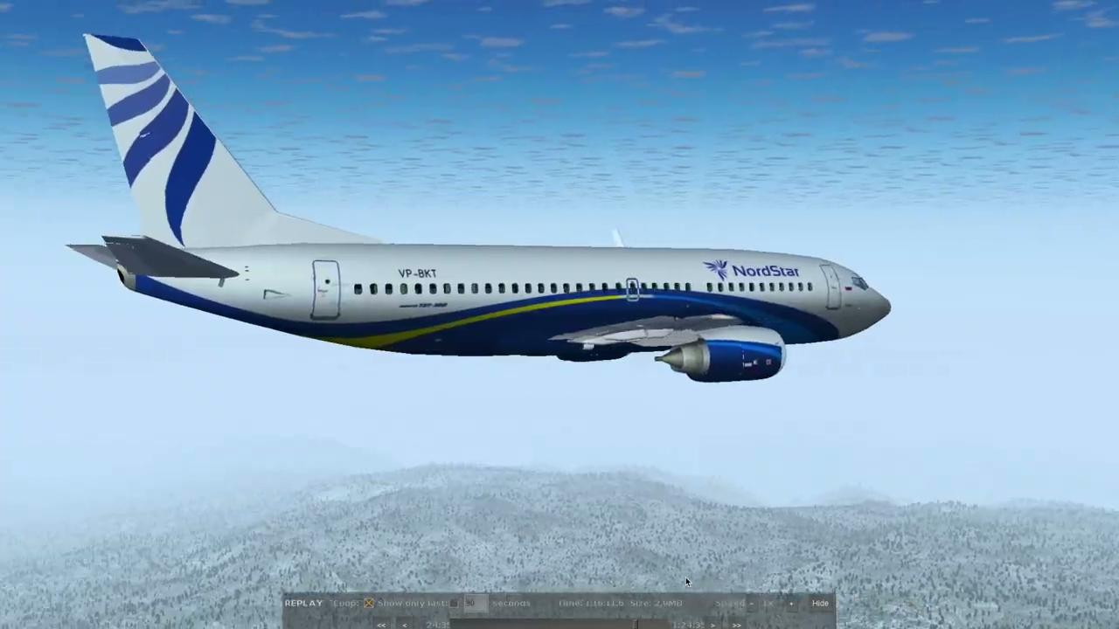
Simulation: Video Time!

Slide 15

Hire Us to Fly You Into the Mountains!

